Slide 1
Fundamentals of Cascading Styling Sheet
Web Design and Development

Slide 2
Inline, Internal and External CSS
Fundamentals of Cascading Styling Sheet (CSS)

Slide 3
Cascading Style Sheets (CSS)
Specifies the presentation and styling of an html or xml document
What does the syntax contain?
CSS syntax mainly contains two components,
Selection
Declaration
Now the Declaration further contains at least two components
Property
Value

Slide 4
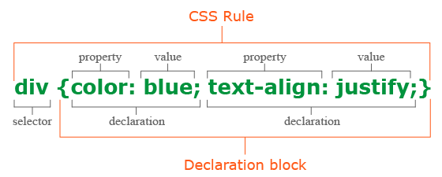
CSS Syntax

Slide 5
Ways to Write CSS
There are total three ways you can write CSS for your website
Inline CSS
Internal CSS
External CSS (preferred choice)

Slide 6
1. Inline CSS
<head>
<title>Inline CSS Example</title>
</head>
<body>
<h1 style="color: blue; font-size: 24px;">This is a heading</h1>
<p style="color: green;">This is a paragraph with inline styling.</p>
</body>

Slide 7
2. Internal CSS
<head>
<title>Internal CSS Example</title>
<style>
h1{
color: blue;
font-size: 24px;
}
p {
color: green;
}
</style>
</head>
<body>
<h1>This is a heading</h1>
<p>This is a paragraph with internal CSS styling.</p>
</body>

Slide 8
3. External CSS (preferred)
index.css
style.css
<head>
<title>External CSS Example</title>
<link href=“styles.css”>
</head>
<body>
<h1>This is a heading</h1>
<p>This is a paragraph with internal CSS styling.</p>
</body>
h1{
color: blue;
font-size: 24px;
}
p {
color: green;
}

Slide 9
Selectors and Types
Fundamentals of Cascading Styling Sheet (CSS)

Slide 10
Cascading Style Sheets (CSS)
Selectors are used to select and target HTML elements/tags, that we want to style.
Plays and important role in separating the structure (html) from the presentation(css).
These are the common types of selectors,
Universal Selector * { code } | Element Selector p { code } | Class Selector .cls { code } | ID Selector #id { code } | Attribute Selector input[type=“text”] { code }
Group Selector h1, h2, p { code } | Descendant div p { code } | Child Selector div > p { code } | Adjacent Sibling h1 + p { code } | General Sibling h1 ~ p { code }

Slide 11
1. Universal Selector
Selects every single element from the document
Global styles to reset or normalize default browser styling
* {
margin: 0;
padding: 0;
}

Slide 12
2. Element Selector
Selects all elements of a particular type (e.g., all p tags, div tags, h1 tags etc.)
Used to apply styles to all occurrences of a specific HTML tag.
p {
color: blue;
}

Slide 13
3. Class Selector
Selects all elements with a specific class attribute
Allows re-usability of styles across multiple elements (e.g., Bootstrap, Tailwind and other frameworks)
Specified by a dot “.”
.highlight {
background-color: yellow;
}

Slide 14
4. ID Selector
Selects a single element with a specific ID attribute (ID must be unique)
Used when you want to apply style to only a single element
Specified by a hash/number sign “#”
#main-header {
font-size: 24px;
}

Slide 15
5. Attribute Selector
Elements that have a specific attribute or attribute value
Useful for targeting elements based on their attributes (e.g., input types, href values etc.)
input[type="text"] {
border: 1px solid black;
}

Slide 16
6. Group Selector
Selects multiple elements at once, separating selectors with commas
Applies the same styles to different selectors in one declaration
h1, h2, p {
margin: 10px;
}

Slide 17
7. Descendent Selector
Selects all elements inside (descendants of) a specified element, no matter how deeply nested
Useful when you want to apply styles to an element within another element
div p {
color: green;
}

Slide 18
8. Child Selector
Selects only the direct children of a specified element,
More specific than a descendant selector, it only affects the immediate child elements
Denoted by greater than sign “>”
div > p {
font-weight: bold;
}

Slide 19
9. Adjacent Sibling Selector
Selects the element that is the next sibling of another element
Useful for styling elements that immediately follow another specific element
Identified by a plus sign “+”
<h1>Heading 1</h1>
<p>This paragraph will be selected (adjacent sibling).</p>
<p>This paragraph will NOT be selected.</p>
h1 + p {
color: red;
}

Slide 20
10. General Sibling Selector
Selects all siblings that come after a specified element
Styles all the elements that are siblings of a specific element, not just the first one
Identified by a tilde sign “~”
<h1>Heading 1</h1>
<p>This paragraph will be selected.</p>
<div>
<p>This paragraph will NOT be selected because it’s not a
sibling of the h1.</p>
</div>
<p>This paragraph will also be selected.</p>
h1 ~ p {
color: red;
}

Slide 21
Selector’s Summary
Universal Selector (*): Targets everything.
Type Selector: Targets specific tags.
Class Selector: Targets elements with a class.
ID Selector: Targets one unique element.
Attribute Selector: Targets elements with specific attributes.
Group Selector: Applies the same style to multiple selectors.
Descendant Selector: Targets all nested elements.
Child Selector: Targets direct children only.
Adjacent Sibling Selector: Targets the immediate next sibling.
General Sibling Selector: Targets all siblings after a certain element.

Slide 22
Colors, Color Schemes and Gradients
Fundamentals of Cascading Styling Sheet (CSS)

Slide 23
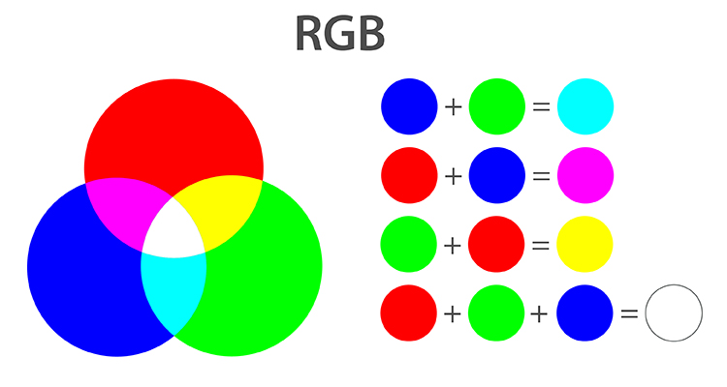
Colors in CSS
CSS supports predefined color names like red, blue, green, etc – there are 140 standard color names in CSS
Easy to use but offer limited control compared to other methods
color: red;
background-color: blue;
Ways of making/manipulating colors,
Hex
RGB(A)
HSL(A)

Slide 24
Colors in CSS – Without Alpha
Hex Color System
RGB Color System
HSL Color System
Hexadecimal (HEX) codes are one of the most common ways to specify colors
They are written as #RRGGBB, where RR, GG, and BB are two-digit hexadecimal values representing red, green, and blue components
color: #ff5733;
/* Orange color */
RGB colors define colors by specifying their red, green, and blue values as rgb(red, green, blue) with each value ranging from 0 to 255.
color: rgb(255, 87, 51);
/* Orange color */
HSL is another way to represent colors based on
hue (the type of color),
saturation (the intensity), and
lightness (how light or dark the color is)
It’s written as hsl
(hue, saturation%, lightness%)
color: hsl(9, 100%, 60%);
/* Orange color */

Slide 25
Colors in CSS – With Alpha (Transparency)
Hex Color System
RGB Color System
HSL Color System
No known transparency mechanism in hex color system.
RGBA is the same as RGB but with an additional Alpha
Alpha component for transparency
The alpha value ranges from 0 (fully transparent) to 1 (fully opaque)
color: rgba(255, 87, 51, 0.7);
/* Orange color with 70% opacity */
HSLA is also same as HSL but again with additional Alpha
Alpha is for transparency
Alpha component to the HSL color model
color: hsla(9, 100%, 60%, 0.5);
/* Same orange but 50% transparent */

Slide 26
Gradients in CSS
Gradients allow you to create smooth transitions between two or more colors
Adding depth and a modern look to your web designs
There are mainly two types of gradients in CSS,
Linear Gradient (Straight or Line)
Radial Gradient (Round or Circular)

Slide 27
Linear Gradient
Gradients allow you to create smooth transitions between two or more colors
Adding depth and a modern look to your web designs
There are mainly two types of gradients in CSS,
Linear (Straight or Line)
Radial (Round or Circular)
background: linear-gradient(direction, color-stop1, color-stop2, ...);
background: linear-gradient(to bottom, red, yellow);
background: linear-gradient(to right, blue, green, yellow, orange);
background: linear-gradient(45deg, red, blue);
background: radial-gradient(circle, red, yellow);
background: radial-gradient(ellipse at center, purple, orange);
background: radial-gradient(circle at top left, blue, white);

Slide 28
Directions Using Keywords in Linear Gradients
There are 8 possible directions when using keywords:
to right
to left
to top
to bottom
to top right
to bottom left
to top left
to bottom right

Slide 29
Box Models in CSS
Fundamentals of Cascading Styling Sheet (CSS)

Slide 30
Box Model in CSS
In CSS, every element on a webpage is considered a box
This concept is called the CSS Box Model, and it defines how the space around an element is structured and rendered
The box model determines how elements are sized, spaced, and aligned, and it consists of four main components:
Content
Padding
Border
Margin

Slide 31
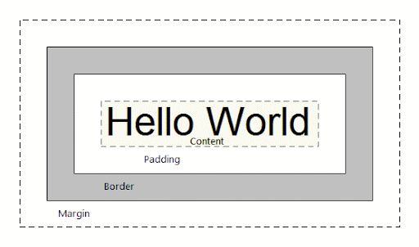
Box Model in CSS
1. Content
This is a sample div
<div>
This is a sample div
</div>
2. Padding
This is a sample div
3. Border
This is a sample div
4. Margin
This is a sample div

Slide 32
Box Model - Content
The actual content inside the element is like text, an image, or other content
The size of this area is controlled by properties like width and height
something {
width: 200px;
height: 100px;
}

Slide 33
Box Model – Padding and Margin
The space between the content and the element's border is padding, space outside the element’s border is margin
Padding and margin both are transparent, and can be set individually for each side (top, right, bottom, left)
Can be set for all the sides at once
padding: 20px; /* all sides */
padding: 20px 50px; /* top-bottom and left-right */
padding-top: 10px; /* top only */

Slide 34
Box Model - Border
The border surrounds the padding (or content if padding isn’t set)
It can have a style (solid, dotted, dashed, etc.), thickness, and color
border: 2px solid black;

Slide 35
Box Sizing: Content Box
The box-sizing property in CSS determines how the width and height of an element are calculated.
It controls whether padding and borders are included in the element's specified width and height or not.
Total size of the box (including padding and border):
Total width = 200px (content) + 20px (left padding) + 20px (right padding) + 5px (left border) + 5px (right border) = 250px
Total height = 100px (content) + 20px (top padding) + 20px (bottom padding) + 5px (top border) + 5px (bottom border) = 150px
So, although you specified width: 200px and height: 100px, the total size of the box becomes 250px x 150px.
<div class="content-box-example">
Content Box Example
</div>
.content-box-example {
width: 200px;
height: 100px;
padding: 20px;
border: 5px solid black;
box-sizing: content-box; /* Default behavior */
}

Slide 36
Box Sizing: Border Box
Opposite to content-box, the total size of the element remains what you specify, and the padding and border don’t increase its size
<div class=“border-box-example">
Border Box Example
</div>
In this example:
Width = 200px (total, including content, padding, and border)
Height = 100px (total, including content, padding, and border)
Breakdown of the 200px width:
The content width is reduced to make room for padding and border.
Padding and border are included in the total width and height.
So, the element’s total size remains exactly 200px x 100px, even though it has padding and borders.
.border-box-example {
width: 200px;
height: 100px;
padding: 20px;
border: 5px solid black;
box-sizing: border-box;
}

Slide 37
Text and Font Styling
Fundamentals of Cascading Styling Sheet (CSS)

Slide 38
Text and Font-Styling
There are several properties that can be applied to the text,
Properties | Values | Output
color | color names, hex codes, RGB, HSL | Changes the color of the text. Example: color: red;, color: #ff0000;, color: rgb(255,0,0);
font-family | Font names, generic family names | Sets the typeface of the text. Example: font-family: Arial, sans-serif;
font-size | px, em, rem, %, pt | Sets the size of the text. Example: font-size: 16px;, font-size: 1.5em;
font-weight | normal, bold, bolder, lighter, 100–900 | Sets the boldness of the text. Example: font-weight: bold;, font-weight: 700;
font-style | normal, italic, oblique | Defines if the text is italicized. Example: font-style: italic;
line-height | number, px, em, % | Adjusts the space between lines. Example: line-height: 1.5;
text-align | left, right, center, justify | Aligns the text horizontally. Example: text-align: center;

Slide 39
Text and Font-Styling
There are several properties that can be applied to the text,
Properties | Values | Output
text-decoration | none, underline, overline, line-through | Adds or removes text decorations. Example: text-decoration: underline;
letter-spacing | normal, px, em | Adjusts the space between characters. Example: letter-spacing: 2px;
word-spacing | normal, px, em | Adjusts the space between words. Example: word-spacing: 5px;
text-transform | uppercase, lowercase, capitalize, none | Transforms the case of the text. Example: text-transform: uppercase;
text-shadow | h-shadow v-shadow blur color | Adds a shadow to the text. Example: text-shadow: 2px 2px 5px gray;
white-space | normal, nowrap, pre, pre-wrap, pre-line | Controls text wrapping and white space. Example: white-space: nowrap;
vertical-align | baseline, top, middle, bottom | Vertically aligns inline or inline-block elements. Example: vertical-align: middle;

Slide 40
Text and Font-Styling
There are several properties that can be applied to the text,
Properties | Values | Output
direction | ltr (left-to-right), rtl (right-to-left) | Sets the text direction. Example: direction: rtl;
text-indent | length, % | Indents the first line of text. Example: text-indent: 50px;
font-variant | normal, small-caps | Changes the text to small caps. Example: font-variant: small-caps;

Slide 41
Color:
Sets the color of the text. You can specify color names, hex codes, RGB, or HSL values to style text color.
p { color: blue; }
Font-family:
You can specify a specific font or a generic font family like serif, sans-serif, etc. Multiple font names are listed as a fallback in case the first font isn’t available.
p { font-family: "Arial", sans-serif; }
Font-size:
Specifies the size of the text. Values can be specified in pixels (px), ems (em), percentages (%), or rems (rem).
h1 { font-size: 36px; }
Font-weight:
Defines the boldness or weight of the text. Can be set to normal, bold, bolder, lighter, or numeric values (100 to 900) where 400 is normal and 700 is bold.
strong { font-weight: bold; }
Font-style:
Specifies whether the text should be italicized. Common values are normal, italic, and oblique.
em { font-style: italic; }
Line-height:
Controls the space between lines of text. Can be defined as a number, percentage, or length. A value of 1.5 means 1.5 times the size of the font.
p { line-height: 1.5; }
Text-align:
Horizontal alignment of text. Can be set to left, right, center, or justify (spreads the text evenly across the line).
h2 { text-align: center; }
Text-decoration:
Adds decoration to the text, such as underlining or line-through. Common values include none, underline, overline, and line-through.
a { text-decoration: underline; }
Letter-spacing:
The space between characters. Can be used to make text more spread out or condensed by defining a specific value in px, em, etc.
h1 { letter-spacing: 2px; }
Word-spacing:
Space between words. Similar to letter-spacing, but for the space between words.
p { word-spacing: 5px; }

Slide 42
Text-transform:
Controls the capitalization of text. Common values include uppercase, lowercase, and capitalize (capitalizes the first letter of each word).
h3 { text-transform: uppercase; }
Text-shadow:
Adds a shadow effect to the text. You can define the horizontal and vertical offsets, blur radius, and color of the shadow.
h2 { text-shadow: 2px 2px 5px gray; }
White-space:
Controls how white space inside an element is handled. Values like normal, nowrap, and pre control whether text wraps, collapses spaces, or preserves them.
pre { white-space: pre; }
Vertical-align:
Aligns inline or inline-block elements vertically relative to their containing element. Common values are baseline, middle, top, and bottom.
img { vertical-align: middle; }

Slide 43
Units and Measurements
Fundamentals of Cascading Styling Sheet (CSS)

Slide 44
Units and Measurements
Used to define various aspects of web elements such as size, spacing, positioning, and more
These units help in determining how big or small elements like fonts, boxes, margins, and paddings are, ensuring the design scales and fits different screen sizes and resolutions
There are two categories,
Absolute Units
Relative Units

Slide 45
1. Absolute Units
Absolute units are fixed and do not scale according to the viewport or parent elements
They remain the same regardless of the user’s screen or zoom level, making them predictable but not always responsive

Slide 46
1. Absolute Units
Absolute Unit | Value | Description
px | Pixels | 1 pixel = 1 dot on the screen (fixed size).
cm | Centimeters | 1 cm = 37.8 pixels.
mm | Millimeters | 1 mm = 3.78 pixels.
in | Inches | 1 inch = 96 pixels.
pt | Points | 1 point = 1/72 of an inch (1pt = 1.33px).
pc | Picas | 1 pica = 12 points (1pc = 16px).

Slide 47
2. Relative Units
Relative units are flexible and scale depending on the size of other elements (such as the parent element or viewport)
They are ideal for creating responsive designs

Slide 48
2. Relative Units
Relative Unit | Value | Description
% | Percentage | Defines size relative to a parent element’s dimension. Example: 50% means half the size.
em | Element (em) | 1 em equals the current font size of the element. Used for scalable typography.
rem | Root em | 1 rem equals the font size of the root element (usually the HTML element).
vw | Viewport Width | 1 vw equals 1% of the width of the viewport.
vh | Viewport Height | 1 vh equals 1% of the height of the viewport.
vmin | Viewport Minimum | 1 vmin equals 1% of the smaller dimension (width or height).
vmax | Viewport Maximum | 1 vmax equals 1% of the larger dimension (width or height).
ch | Character | Represents the width of the "0" character in the current font.
ex | x-height | Represents the x-height (height of the lowercase "x") in the current font.

Slide 49
The End
Any Questions?

